Slide 1
MCB 638
Live Session 1
Monday

Slide 2
Agenda for Live Session 1
1. Welcome and Introductions
Name
Job
State/Country
Something fun that happened in last year
2. Ground rules
3. Logistics
4. Advice
5. Course Overview
6. Project
7. Summary of Key Points from Week 1, Kappa
8. Wrap-up/feedback

Slide 3
Ground rules
Review the asynchronous portion of class BEFORE each session
One person speaking at a time – Raise hand or Type in Chat
Start and end on time – Plan to sign in 5-10 minutes before class starts
Avoid turning your video off
Use headset
If something is not working right, try another browser
If difficulties continue, contact 2SU Student Support at 844-797-5622

Slide 4
Logistics
2SU – Course material, grades. Be sure to click on ‘Upload’ when posting your work. If nothing is posted, no grade will be given. See next slide for guidance.
LaunchPad – some Homework is to be done here.
Live Sessions – University policy – must attend 9 of 10 sessions. All are recorded so you can watch later
Quizzes and the final require a password, which will be posted to our Class Wall prior to each. The final will be held during our Live Session 11.
Class Wall – all my communication to be posted on Class wall as others may have same question. If you have a private question, feel free to e-mail me at dryan01@syr.edu
Please use your syr.edu email address
Files – there are many documents including rubrics posted under Files, including our Syllabus with Due Dates
All work is 10% off per day late, up to 4 days, then no credit can be given.
2nd Book- “Understanding Variation” – Required reading, needed for Week 8
Office hours – are posted as Zoom meeting in 2SU. Most are Thursday evenings from 9-10 pm Eastern time zone. All are welcome. No appointment needed. First come, first served

Slide 5
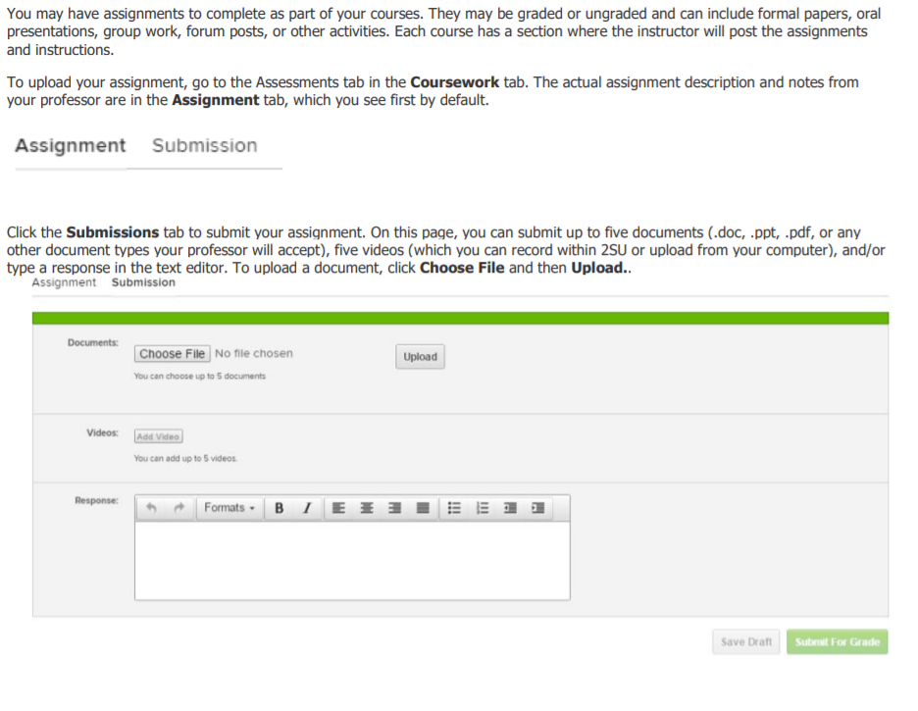
Posting assignments in 2SU
Be sure to click
on the Upload
button

Slide 6
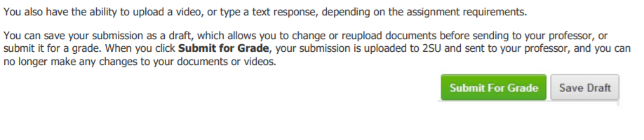
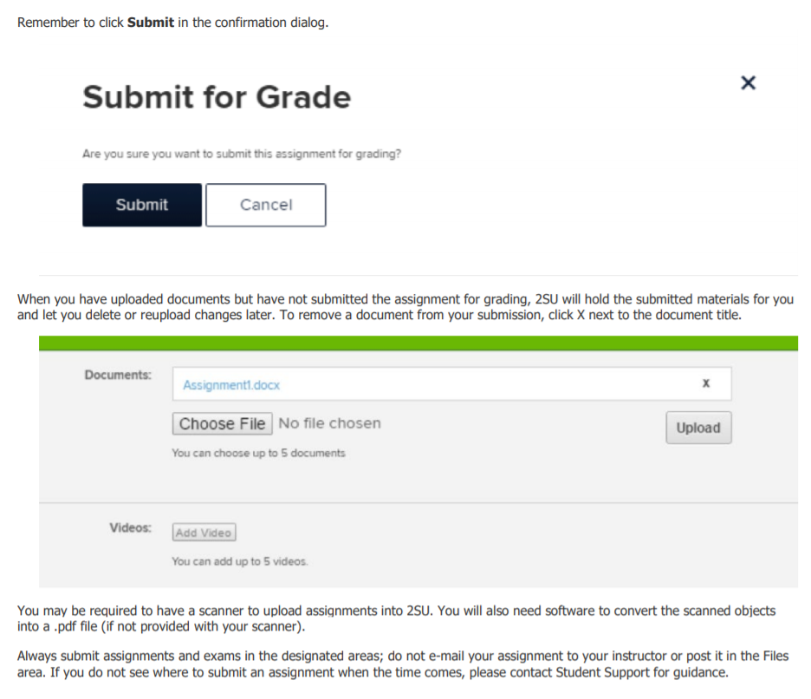
Posting assignments in 2SU, continued
Check to be sure
your intended
File has posted
I have seen an increase in
assignments not posted
when a student types a message..
(such as Dear Professor,
please see my assignment
below…)

Slide 7
Advice from Students in Previous Classes
Don’t drag your feet on the project! Don’t wait until the last week! Get the hardcopy textbook, the online one is a pain to use Don’t read the textbook. Strong recommendation to choose a continuous y Choose a main measure that you can gather data on daily
Play the asynchronous videos as many times as possible Consider listening to replays using the 1.5X or 2.0X playback mode which helps get refreshers but in less time.
Do something related to the final project every week
Pick an interesting project topic Don’t be afraid to ask for project guidance
Build models in excel to help you - and keep notes on the rules for the model
Keep up with the work because each topic builds on the next one.
1) Practice the excel stuff 2) Find people in class to study/practice with 3) attend office hours If you want to print out the a-synch work, doing so with keyframes will save paper by highlighting the summary slides Ensure they are keeping up with the videos and slides rather than spending time with the text Do a little of your project as the material is covered. Take good notes and label your notes because there is a lot of material to retain If you're struggling with a topic, try to review practice problems early and seek assistance with your success advisor and Wyzant Keep calm, do the homework, you’ll be fine

Slide 8
Course Overview
Data analysis and decision making – in the context of DMAIC
Outline
MBC 638 Data Analysis
Week | Content Covered
1 | DMAIC, continuous v. discrete data, y=f(x), SQL, Operational definitions, descriptive statistics, charts/graphs/soft tools, Kappa measure, repeatability/reproducibility concept
2 | Analyzing a current process, developing a process map, id non-value added steps/waste, identifying key metrics, calculating mean & std deviation & SQL
3 | Normal & binomial distributions, CLT, using Excel, hypothesis testing, alpha & beta
4 | Chi-square test of independence
5 | Confidence intervals and sample size
6 | Correlation, simple linear regression
7 | Multiple regression, F-test, model building, categorical input variables
8 | Different control charts, using CCs to problem solve, signal v. noise
9 | Time series forecasting, autocorrelation, 1st order autoregressive model, moving average model, exponential smoothing model
10 | Course summary

Slide 9
Grading
Total Points | Final Grade
95-100 | A
90-94 | A-
87-89 | B+
84-86 | B
80-83 | B-
76-79 | C+
72-75 | C
66-71 | C-
<65 | F
ASSIGNMENTS | No. of Points | Total Points
Class Participation | 10 | 10
Quizzes | 2 | 20
Homework Assignments | 6 | 20
Problem Definition Worksheet | 1 | 10
Process Improvement Project with Storyboard | 1 | 20
Final Exam | 1 | 20
Total Points |  | 100
Total Points | Final Grade
95-100 | A
90-94 | A-
87-89 | B+
84-86 | B
80-83 | B-
76-79 | C+
72-75 | C
66-71 | C-
<65 | F
Note: There is no extra credit

Slide 10
DMAIC
Define
Measure
Description:
Clearly identify the business problem / performance gap (output measure), customer, scope, goals and resources.
Key Concepts:
y = f(x)
Types of data
Descriptive statistics and soft tools
Project:
Complete Problem Definition Worksheet
Tools:
Process map
SIPOC
Descriptive statistics
Thought process map
Affinity diagram
Sigma Quality Level (SQL)
Description:
Validate your measurement system and collect baseline data.
Key Concepts:
Mapping a process/value-stream, forms of waste, measurement error, reproducibility, repeatability
Project:
Identify potential inputs, develop operational definitions, develop data measurement/collection plan, validate measurement system, collect baseline data, calculate SQL.
Tools:
Operational definitions
Kappa
Process map (detailed)
Data measurement plan
Data stratification tree
Histogram
Trend/ line chart
Pareto chart
Fishbone (cause/effect) diagram
Week 1
Week 2

Slide 11
Analyze
Description:
Analyze, describe, and present the data to discover the root cause(s), identify/prioritize critical inputs (x’s), determine the inputs impact on the output.
Key Concepts:
Inferential statistics, common distributions, developing a hypothesis, determining the likelihood some event happens based on a sample (calculating probabilities), Using the normal distribution as the “go to” distribution.
Project:
Write a null and alternative hypothesis statement.
Tools:
Hypothesis testing
Chi-square test for independence
Key Concepts:
Collecting sample data, how confidence intervals and sample size are related.
Project:
Utilize the sample size formula.
Tools:
Confidence intervals.
Key Concepts:
Determining input’s (x) impact on the output (y).
Project:
Use regression to identify relationships between the output (y) and inputs (x’s).
Tools:
Correlation
Simple linear regression
Multiple regression
Scatterplot
Trend/ line chart
Pareto chart
Fishbone (cause/effect) diagram
Week 3 & 4
Week 5
Week 6 &7

Slide 12
Improve
Control
Description:
Develop potential solutions, select best solution, pilot solutions, measure results, document new process.
Key Concepts:
Discover y= f(x)
Project:
Implement a solution, run a pilot, evaluate the results, complete a hypothesis test.
Tools:
Affinity diagram
Fishbone cause/effect diagram
Pareto
Control charts
Hypothesis testing
Process map
Solution selection matrix
Description:
Implement process changes and controls. Verify expected performance was achieved, monitor performance to sustain new levels.
Key Concepts:
Xbar/R and ImR control charts, Different control charts applicable to different processes, time series forecasting methods predict future performance.
Project:
Utilize an appropriate control chart and /or time series forecasting method
Tools:
Control charts
Time series analysis
Operational definitions
Process map
Sigma Quality Level (SQL)
Week 8
Week 9

Slide 13
Process Improvement Project
Project Selection Criteria:
Select an issue or opportunity that can be written as a problem statement.
Must be within your sphere of influence.
Is not an attempt to solve world hunger.
Uses data that is accessible to you or can be collected in a reasonable amount of effort/time.
You have the ability to measure the current and future state. You have access to baseline data or can collect it.
Preferably uses more continuous data (rather than all discrete data).
Fixing this problem will provide value. You should develop a business case to support working this issue (consider your time and others when calculating ROI.)
Examples:
Product quality is poor
Expenses are too high
Output of your organization is too low or not meeting customer needs
Wait time is too long
Blood pressure is too high
Running speed is too slow
Electricity usage is too high

Slide 14
The Project - Examples
Reduce cost usage variance
Reduce the time it takes to produce the monthly report
Reduce test variability between labs
Reduce the number of steps in the quoting process
Improve the ratio of dollars spent per prescription written
Improve the ratio of dollars spent per dollars made
Reduce the time it takes to close a real estate deal
Generate incremental revenue from existing customers
Reduce backlog of claims
Increase server utilization
Minimize raw material inventory
Reduce time to mitigate/process a raw material discrepancy
Reduce the number of delays and cancellations
Optimize a truck delivery
Reduce gallons of fuel consumed
Reduce overall processing time of RFQs
Reduce days required to ship parts
Reduce overtime
See longer list posted
under Files

Slide 15
The Project – Problem Definition Worksheet
Complete each section below:
A) Problem Statement: Define your problem. What pains are you (or your customers, family, clients, etc.) experiencing? What is broken, wrong or not working? How do you know that you have a problem? What is telling you this? What is your evidence?
B) Business Impact: Why should you fix this problem? What is the estimated benefit for solving this problem? What is this problem worth in dollars? How will you measure success? What is your key output (y)?
C) Goals: What are your improvement objectives, goals or targets? How much “better” do you want to be? Quantify this goal.
D) Project Scope: What are your boundaries? What is the first step and last step of the process you need to fix? What is not within your scope?
E) Team: Who is the process owner/champion? Who do you need to work with or involve to analyze and/or impact this process?
F) Project plan:(very high-level): Estimate time (or date) per DMAIC step. Develop a rough timeline.
G) Process Map: What are the steps in the process you are trying to fix? Document the flow of process steps (of the process you are working to improve). This should be a high-level flow chart.

Slide 16
A. Problem Statement Tips
No root causes should be included
No solutions should be included
Just state the problem
If you have no idea how to solve this problem, it is likely a good candidate for this class

Slide 17
For D. Project Scope and G. Process Map – Helpful Hints
Example: If your project is on reducing the time it takes to process a claim
Good:
Scope: The first and last steps should be of the work to process a claim (First step: Open the claim, Last step: log the decision/action taken)
Map out the current state steps that are done to process a claim (Open the claim, read the details, investigate the purpose, check the list of approved situations for a payment, contact the customer to discuss the claim, obtain input from your manager, decide to make a payment. If yes, make the payment. If no, … log the decision/action taken)
Not good:
Scope: Stating the first and last steps of the actions you will take on your project (First step: Determine how long it takes to process a claim, Last step: train all staff on the new process)
Map out the actions you will take on your project (Determine how long it takes to process a claim, talk to manager about doing this project, form a team, determine reasons for long time to process a claim, identify ways to shorten the time, train all staff on the new process)
→ This will result in points deduction on the assignment

Slide 18
Process Improvement Project
-Requirements-
The final submission should be 1 file, in slide format, created in PowerPoint (not pdf).
It should include 2 parts:
Executive summary slide – 1 slide Storyboard (specific requirements below).
2) Back-up slides – additional 5-15 slides (specific requirements pgs. 3-4). This is not a repeat/copy of your storyboard. The back-up slides should detail and support the content of your storyboard.
*************************************************************************************************************
1) Executive Summary : Storyboard (should be presented in 1 PowerPoint slide)
Follow the DMAIC steps
Include the problem statement and baseline
Include several tools of the required (at least 5 different) tools/techniques (present relevant key tools to best tell your story).
Be readable; summarize and condense exhibits where necessary
Use arrows, call out boxes, and balloons to highlight questions and key learnings
Display data/charts supporting your findings and conclusions
Show results or expected results

Slide 19
Process Improvement Project
-Requirements-
2) Back-up slides - following the Storyboard include 5-15 slides containing the answers to the following questions.
DEFINE
What is your goal? How will you know if you’ve been successful?
Have clear operational definitions been established for your inputs and outputs?
What is the process you’re trying to improve? What are the current steps of the process?
MEASURE
Include your Data Measurement Plan or Data Stratification Tree
What type of data did you collect (cost, cycle time, changeover time, yield, machine utilization, scrap, rework, defects, inventory)?
Was that data continuous or discrete?
Did you collect your own data, or did you use existing data?
How much data did you collect and why? What is your ideal sample size using the sample size formula? What is the risk if you collected fewer samples?
How was your data collected? Describe the methods you used to collect it.
Where could you have measurement error? How much measurement error do you have? What could you do to minimize your measurement error?

Slide 20
Process Improvement Project
-Requirements-
2) Back-up slides continued:
ANALYZE
What tools did you use to analyze the data? (Utilize at least 5 different tools/techniques and show evidence and detail of the tool/technique).
What is the data telling you? What did you discover?
What is the SQL for the old and new process?
IMPROVE
What solutions did you propose and/or implement? Did you successfully improve your process? What did you learn about your process?
CONTROL
How will you use this information to “hold the gains” of your improvement or make the next round of improvements in your process?

Slide 21
Data Measurement Plan
Data Source and Location
How Will Data Be Collected
Who Will Collect
Data
When Will Data Be Collected
Target
Sample
Size
Performance Measure
Develop rating scale & assess performance
5/12
% of orders per Sales Rep by skill level type
average & range of Sales Rep skill levels
Susie
Susie
N/A
% type of call
Manual data collection
Use data collection form
All
5/11-6/2
1000 calls
no. of hours of training per month
John’s training spreadsheet
Manual data collection
John
5/20
12 mo
Example
total orders placed by month
% new orders are of total orders
% order revenue of total revenue by month
IB performance reports
Pull from report
Leanne
By 6/3
28 mo
customer attitude rating by order type
Manual data collection
Use data collection form
All
5/11 - 6/2
500 orders
Average call duration for new order vs. other
Manual data collection
Use data collection form
All
5/11 - 6/2
500 orders
wait time for each call
Obtain from other team
Aspect reports
Leanne
tbd
tbd
% of calls transferred to OB due to pricing issues
Manual data collection
Use data collection form
All
5/11 - 6/2
1000 calls
mystery call /silent monitoring results (points per call)
Monthly mystery call results
Compile Pamela’s data
Leanne
By 6/3
30
% of orders resulting in backorders
Manual data collection
Use data collection form
All
5/11 - 6/2
500 orders
calls, orders, total rev, per Sales Rep per month
IB performance reports
Pull from report
Susie
By 6/3
28 mo
No. of inbound calls per day
IB performance reports
Pull from report
Susie
By 6/3
28 mo
order revenue per Sales Rep per month
IB performance reports
Pull from report
Susie
By 6/3
28mo
Total revenue per month
IB performance reports
Pull from report
Susie
By 6/3
28 mo
Revenue per month by product type
SN report
Pull from report
Leanne
By 6/3
ytd

Slide 22
Data Stratification Tree
Questions About Process
Stratification factors
X Variables
Measurements
Are orders impacted by the sales rep skill-levels (systems, product, pricing, listening, ability to follow the process)?
Skill level
% of orders per Sales Rep by skill level type
average & range of Sales Rep skill levels
What % of the calls are order related?
Type of call
% type of call
Does the Sales Rep have the right skills to improve selling more orders?
Training
no. of hours of training per month
total orders placed by month
% new orders are of total orders
% new order revenue of total revenue by month
Do new orders vary by month ?
Time of year (mo.)
Do new orders change by the receptiveness of the customer?
New Orders
Customer attitude
Example
(Output Y)
customer attitude rating by order type
Are orders impacted by call duration?
Average call duration for xyz order vs. other orders
Call duration
Are orders impacted by call wait time?
Wait time
wait time for each call
Are orders impacted by pricing issues?
Pricing Issue
% of calls transferred to OB due to pricing issues
Are orders impacted by whether or not the Sales Rep follows the written process?
Written process
mystery call /silent monitoring results (points per call)
Do new orders vary by the availability of the product (not on backorder)?
No.of backorders
% of orders resulting in backorders
Do the current targets impact orders?
Target settings (calls, orders, revenue)
calls, orders, total rev, rev per mo. per Sales Rep

Slide 23

Name of your project
Process owner: or your Name
Key Dates --->
Team
Launch
Define
Measure
Analyze
Improve
Control
DEFINE
MEASURE
ANALYZE
IMPROVE
Storyboard
template
CONTROL
TEAM MEMBERS

Slide 24
Process Improvement Project
-Rubric-
Content Requirements | Possible Points
A) An executive summary is provided in the storyboard format including: Is the storyboard presented in 1 PowerPoint slide? Follows DMAIC? Are tools/graphs/charts used and clearly visible? Do they support findings and conclusions Are arrows, call-out boxes, etc. used to summarize, highlight questions and key learnings? Are expected results clear? And next steps noted? | 5.0
B)Is it a cohesive presentation opening with the business process and problem statement? The back-up slides (5-15) detail and support the storyboard content. | 2.0
C) Was the success measure clearly identified, operationally defined and baseline identified? (Was the data identified as continuous or discrete, includes SQL?) | 3.0
D) Was the data measurement plan or data stratification tree included? | 1.0
E) Was the data collection method identified? | 1.0
F) Was there rationale for the sample size taken? Use of the formula? Is there any reference to measurement error and how to minimize? | 1.0
G) Are at least 5 different tools and techniques clearly identified? Are the tools linked/ pertinent to the data analysis? | 5.0
H) Does the data analysis clearly tie to the problem conclusion? Is the “discovery” clear to the reader? | 2.0
Total | 20

Slide 25
Summary of Key Points from Week 1
DMAIC, Y=f(x)
Types of Data – Discrete or Continuous
Defects and SQL
Operation Definitions and Describing Data
Soft Tools
Kappa for checking Measurement Error

Slide 26
Discrete or Continuous Data?
Discrete – whole numbers only. You can’t have half of a child
Continuous – measurement – using a scale with numbers possible such as 1.2, 15.85
What type of data is:
Number of blue cars
Temperature
Weight
Inches of snow

Slide 27
Defects and SQL
A defect is not meeting customer requirements.
In terms of your projects, you must calculate SQL which requires you to identify a defect.
Using example of getting pre-launch product data to include in a bid tool – a defect could be anytime I didn’t receive the pre-launch data at least 30 days prior to launch.
For trying to save additional money per week, anytime you didn’t save at least X dollars or X percent of your income per week or per day etc., would be a defect.
For cutting sugar intake, any time you exceeded the daily recommended amount of sugar per day you could count as a defect.
SQL – Sigma Quality Level - A sigma quality level serves as an indicator of how often defects are likely to occur in processes, parts, or products. It can be used to describe if the process is capable of meeting customer requirements. The best possible process in the world would have a Sigma Level of +∞ (infinity) and the worst possible process in the world would have a Sigma Level of –∞ (negative infinity).
We aim for a SQL of 6, Hence the term Six Sigma. The defect level for a 6 Sigma process is 3.4 defects per million opportunities.
Notes:
Filling in a form with 3 blanks, and you fill in 100 forms/day, and you find 20 defects
D=3
U=100
DXU=300
A=20
Defect rate opportunity = A/DU, 20/300= .0666666 X 100 = 6.7%
DPMO = 6.7% X 1MIL = .067X 1,000,000=67,000 ************must convert the percentage to straight decimal like sales tax so .067
SQL = 3
****MUST CALCULATE FOR YOUR PROJECT BEFORE AND AFTER, you should see your SQL go up after your project
SQL table in file share
Creative thinking for projects…..let’s say you want to increase miles walked per day, you could define a defect as any day you walk less than 2 miles, so 1 defect opportunity per unit(day), units per month =30, total possible defects = 1 X 30 = 30, actual defects = 20….etc.

Slide 28
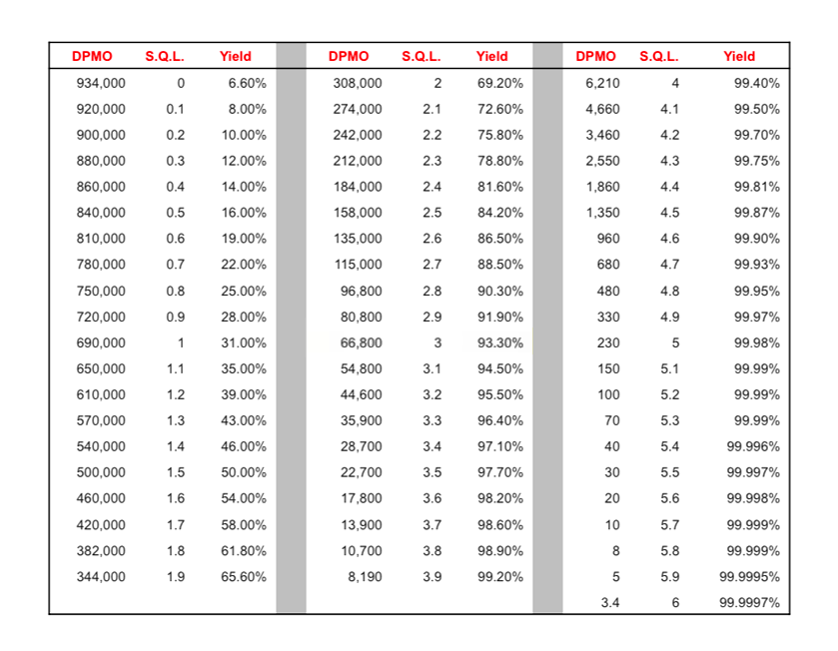
Defects and SQL
Sigma Quality Levels are based on DPMO
How do you calculate DPMO & SQL?
Note: Timeframe can be a day, week, month, year…
Start by defining a defect
A defect could be a late payment, spending for a week that is over your target, a blood pressure measurement over your goal, a day without exercise, etc.
e.g. for a sales order – wrong quantity, wrong item, wrong price = 3 possible defects on each order
1. Defect opportunities per unit: D = 3
2. Units produced per timeframe: U = 100
3. Total possible defects per timeframe: D × U = 300
4. Total actual defects during that timeframe: A = 20
5. Defect per opportunity rate: A ÷ DU = DPO = .067
6. Defects per million opportunities (DPMO): DPO × 1,000,000 = 67,000
7. SQL value (from SQL table): 3
SQL Table
Notes:
Filling in a form with 3 blanks, and you fill in 100 forms/day, and you find 20 defects
D=3
U=100
DXU=300
A=20
Defect rate opportunity = A/DU, 20/300= .0666666 X 100 = 6.7%
DPMO = 6.7% X 1MIL = .067X 1,000,000=67,000 ************must convert the percentage to straight decimal like sales tax so .067
SQL = 3
****MUST CALCULATE FOR YOUR PROJECT BEFORE AND AFTER, you should see your SQL go up after your project
SQL table in file share
Creative thinking for projects…..let’s say you want to increase miles walked per day, you could define a defect as any day you walk less than 2 miles, so 1 defect opportunity per unit(day), units per month =30, total possible defects = 1 X 30 = 30, actual defects = 20….etc.

Slide 29
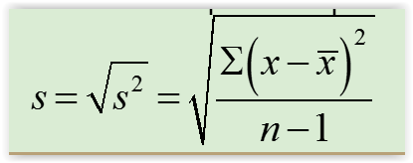
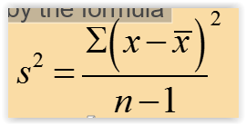
Describing Data
3 Ways to Measure the Center of the Data
Mean(average): To find the mean of the values in a data set, simply add up all the numbers and divide by how many numbers you have.
Mode(most frequent value): The mode of a data set is the data value that occurs with the greatest frequency.
Median(middle point of the data): The median of a data set is the middle data value when the data are put into ascending order. Half of the data values lie below the median, and half lie above. If the sample size n is odd, then the median is the middle value. If the sample size n is even, then the median is the mean of the two middle data values.
Note: Easy to
use Excel to
calculate these
=average
=mode
=median
=max( ) – min( )
=stdev.s
=var.s
3 Ways to Measure the Dispersion or Spread of the Data
Range: The range of a data set is the difference between the largest value and the smallest value in the data set:
Standard Deviation: may be interpreted as the typical difference between a data value and the sample mean for a given data set. i.e. 10
Variance: is approximately the mean of the squared deviations in the sample given by the formula, standard deviation squared, i.e. 100

Slide 30
Kappa – for checking for Measurement Error
Would you use Kappa for discrete or continuous data?
What is the difference between reproducibility and repeatability?
Questions on the formula?
What is a good Kappa level?

Slide 31
What’s next? (from Syllabus with Due Dates)
Class Assignments | Submit / Post Location | Due / Date
Week 1 (Reference : textbook Ch.1, 2 & 3)
Problem Definition Worksheet | Coursework → Assessments | 3 days after Live Session 1 = Oct 8
Week 2
Quiz #1 | Coursework → Assessments | 3 days after Live Session 2 = Oct 15

Slide 32
Questions?

